Slide 1
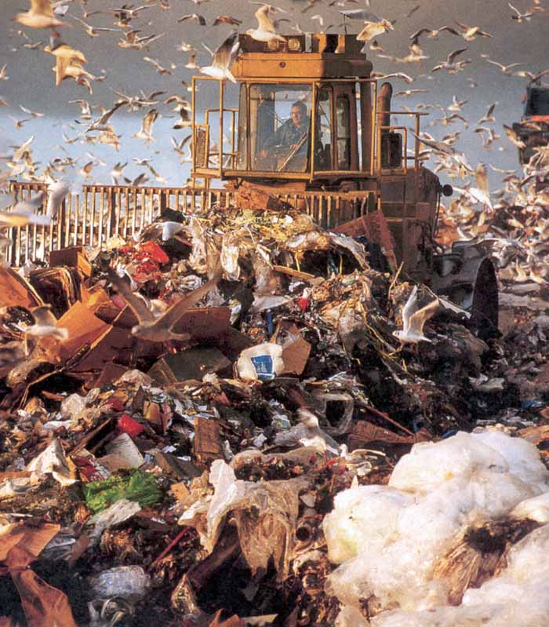
Waste Management
“And willful waste, depend upon’t
Brings, almost always, woeful want!”
Ann Taylor

Slide 2
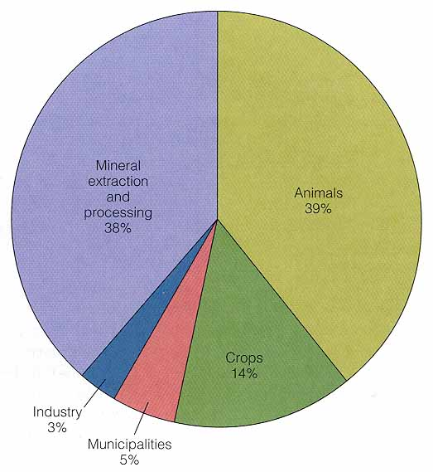
Waste Management
Sources of solid waste
Notes:
This picture is somewhat misleading
Most mining and agricultural waste remains on site
Industrial and municipal waste is a problem due to its nature and concentration in populated areas

Slide 3
Waste Management
We have a huge solid waste disposal problem: cities are producing far too much waste to dispose of
  80% of US trash → landfills
  70% of these will fill and close in next 15 yrs!
  ~ ½ of US cities will run out of landfill capacity in a few years (and $ skyrocketing)
  ½ of states in US will lose landfill capacity in 10 yrs
Notes:
We simply cannot continue with the present trend in waste production or disposal
One major problem is NIMBY with respect to siting of waste facility, incinerator, etc
Therefore they go to places where people have no political power ( a “social justice” issue)

Slide 4
Waste Management
Early view: dilute and disperse
Later → concentrate and contain
Later yet → resource recovery
  Modern integrated waste management goal is to recycle, extract resources, and bury waste so as to create useable land
  3 R’s: reduce, recycle, reuse
Notes:
Early view: low population density & waste → dilute and disperse
Factories were near rivers, so dumped waste there
Later, when too many factories → overcame ability of river to d&d → concentrate and contain
But containment seldom achieved: no containers or leaked (worst = Superfund sites)
Later yet → resource recovery (waste may be a resource, and at same time reduce bulk of waste)
But limits due to $ and technology (entropy problem)

Slide 5
Waste Management
Solid waste disposal (an urban problem)
  US: > 400,000 tons of solid waste per day
W. Germany recycles 15% converts 30% → energy 55% → landfills
Japan 50% 23% 27%
USA 11% incinerates 6% 83%
Notes:
US: > 400,000 tons of solid waste per day
= convoy of collection trucks 550 km long
… in 2 yrs of waste the convoy would stretch → moon

Slide 6
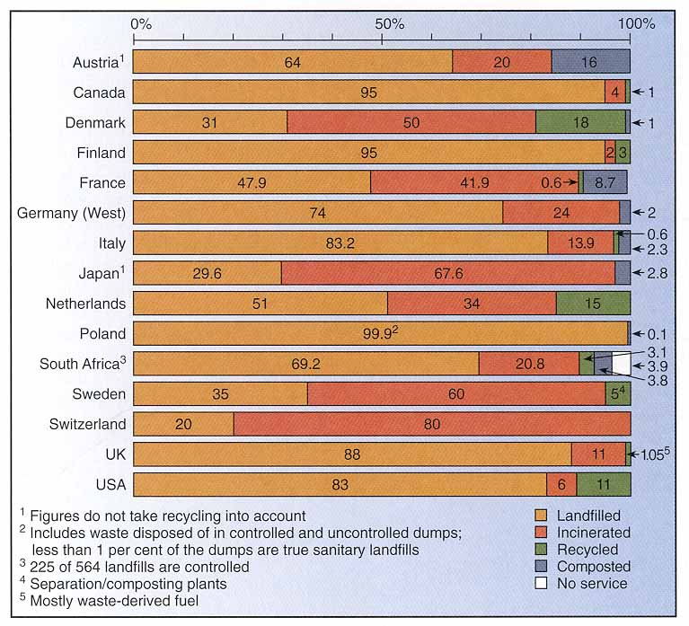
Waste Management

Slide 7
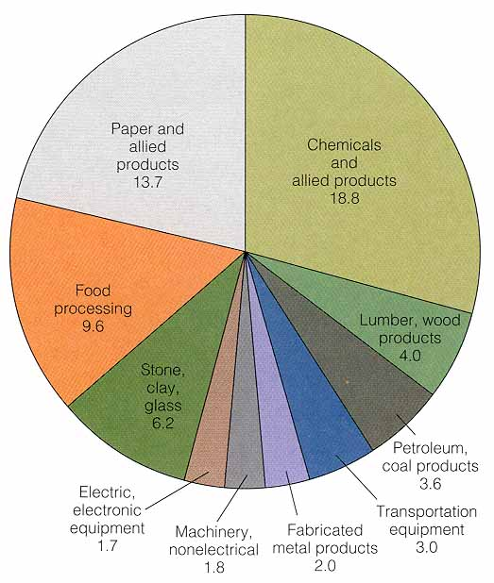
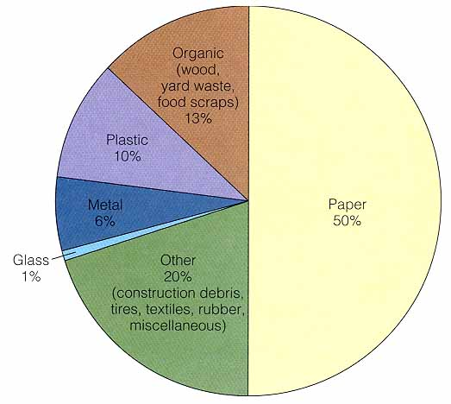
Waste Management
Types of waste for the average site in 1986 (Municipal)
  note role of paper (36%)
  glass and wood are a shame
Ave American → 3.5 lbs of garbage/day
  NYC = 4 lbs Tokyo = 3 lbs
  Paris = 2.4 lbs Hamburg = 1.9 lbs
  Rome = 1.5 lbs
Industrial
Municipal
Notes:
Medical waste is a common urban problem… may be infections
Toxic waste in large cities from industry

Slide 8
Waste Management
Methods of disposal
1. On-site disposal
  By far the most common is kitchen disposal
  Incineration at apartments
  Some industries have stored and dumped on site (such as the infamous Love Canal, etc.)
2. Composting
  Biochemical process to produce humus-like material for soil fertilization
Notes:
Oddly #1 includes home drains and sewers: thus sink disposals & flushing junk down toilet
This is really piping to sewage treatment facility (unless septic system)
Many people with septic tanks are unaware of how to care for them
Bleach, cleansers, chemicals, should be avoided

Slide 9
Waste Management
Methods of disposal
3. Incineration
  900-1000ºC will consume 75-90% of typical waste → ash and non-combustables
  Realistically at present → 50%
  Problems with air pollution (N-O, S-O, CO, heavy metals) and toxic ash escaping
  3R’s are cheaper and more effective
Notes:
900-1000ºC will consume 75-90% of typical waste → ash and non-combustables
Realistically at present → 50%
Obvious benefit for landfills
Also can generate some power
Problems with air pollution (N-O, S-O, CO, heavy metals) and toxic ash escaping
Stack filters and scrubbers effective but $ and must be maintained
3R’s are cheaper and more effective

Slide 10
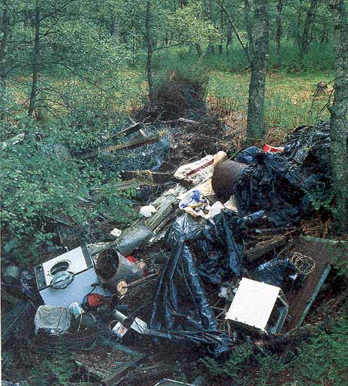
Waste Management
Methods of disposal
4. Open dumps
Notes:
Just dump on a plot of land without regard to leaching, aesthetics, health, etc.

Slide 11
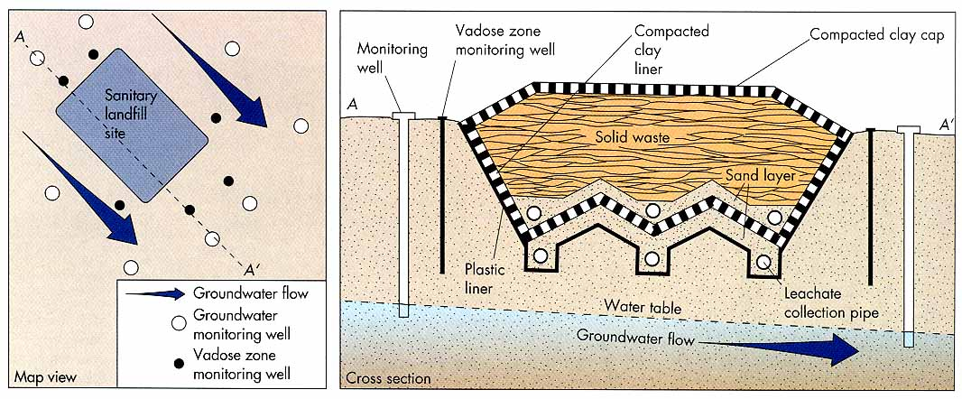
Waste Management
Methods of disposal
5. “Sanitary Landfills”
  Area landfill on flat land
  Depression landfill in hole (typically excavated)
Notes:
Name only makes sense when compared to open dumps
Confine waste to minimum area, compact volume, cover with > 15 cm of soil at end of each day
Impedes water, insects, rodents, animals from ingress
Final cover is > 50 cm of compacted soil (high clay content) to minimize infiltration

Slide 12
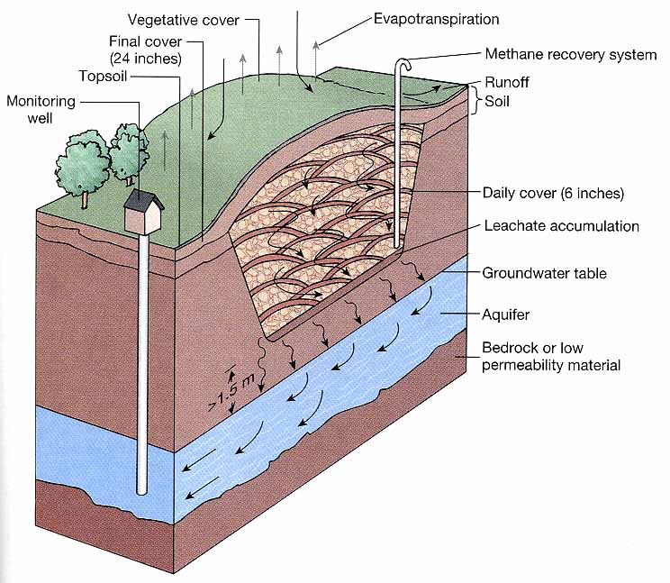
Natural attenuation landfill uses soil processes to attenuate the impact of contaminants

Slide 13
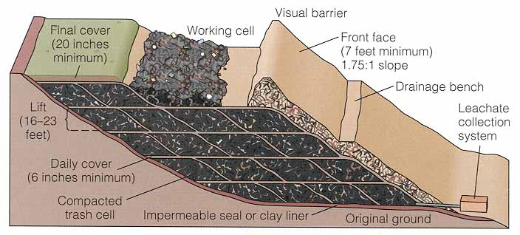
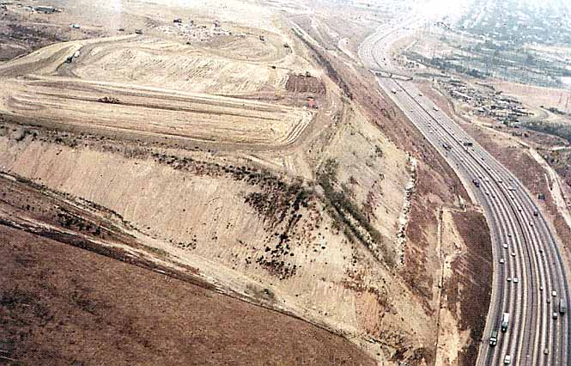

Slide 14
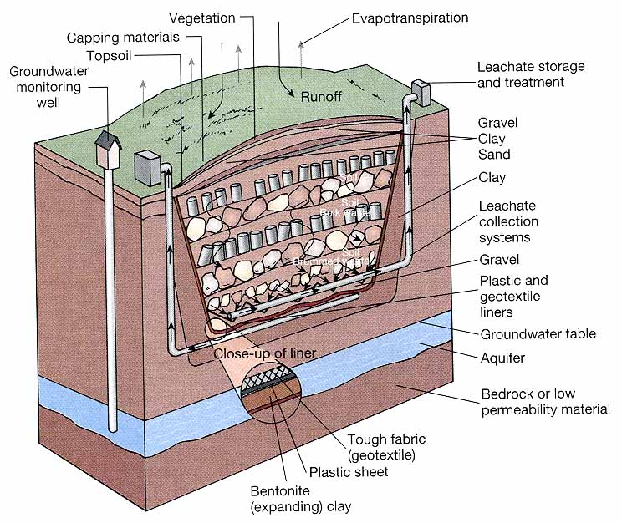
Containment-type landfill collects the leachate and pumps it for storage or treatment

Slide 15
Waste Management
Sanitary Landfills
Potential Hazards:
  Surface or groundwater pollution by leachate
  Methane gas
Notes:
Surface or groundwater pollution by leachate
2 NY landfills of 1930’s → leachate plumes several 100 m wide and several km long
Methane gas
Mostly nuisance, but one home in Ohio exploded
Methane can be an energy resource of collected well

Slide 16
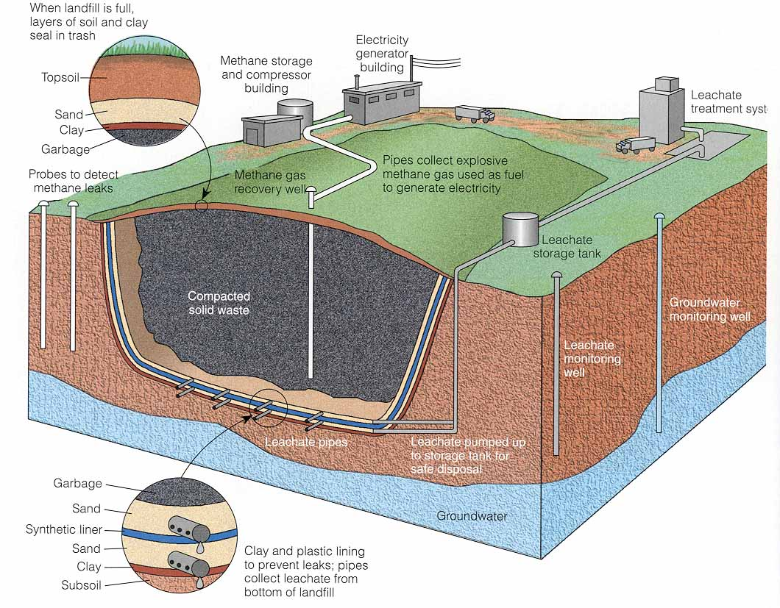

Slide 17
Waste Management
Sanitary Landfills
Site selection:
  Location of groundwater table and flow regime with respect to site
  Climate (arid is best of course)
  Topographic relief
    Low relief is most stable, but groundwater also a factor in humid areas: want it above the water table
  Proximity to population and visual pollution (or air pollution if incinerate)
  Type of soil and rock (best if low permeablility)

Slide 18
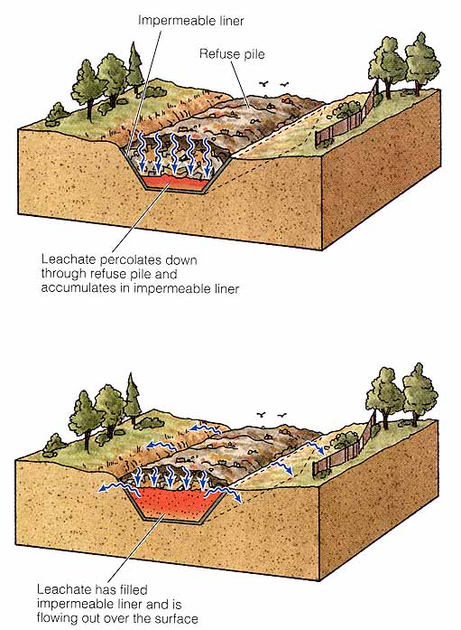
The “bathtub effect” when too much leachate collects and overflows the container

Slide 19
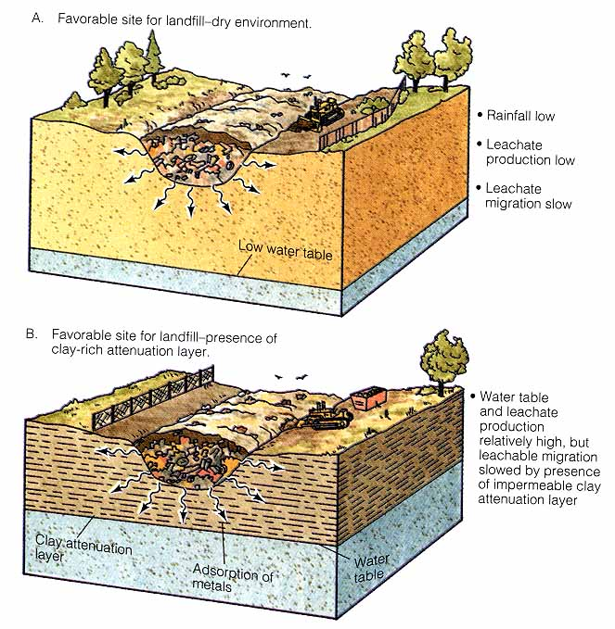

Slide 20
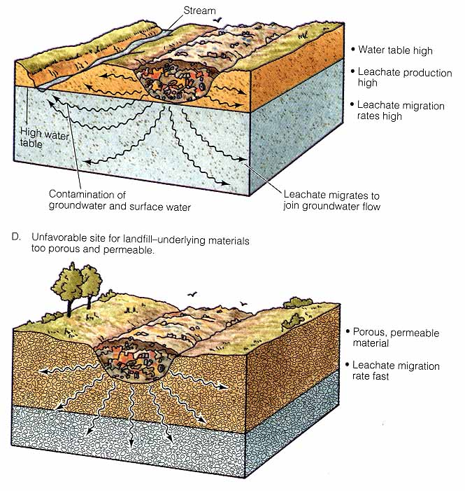

Slide 21
Waste Management
Sanitary Landfills, Considerations:
Things to avoid
  Aquifers like limestone, fractured rock, sand, gravel… any permeable rock
  Swampy areas and wetlands
  Floodplains
Things to look for
  Closer to gully heads where less accumulated water
  Clay pits
  Flat areas with poor porosity (at least near surface)

Slide 22
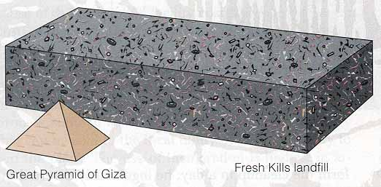
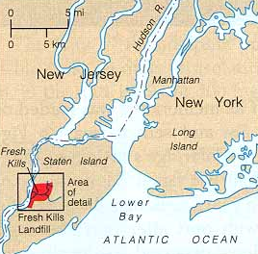
Waste Management
Fresh Kills landfill, Staten Island, NY
the highest point between Maine and Florida
Accepts 13,000 tons of trash/day
25X the volume of the Great Pyramid
Built on marshland
Trash transported by barge
Accepts toxic ash from incinerators

Slide 23
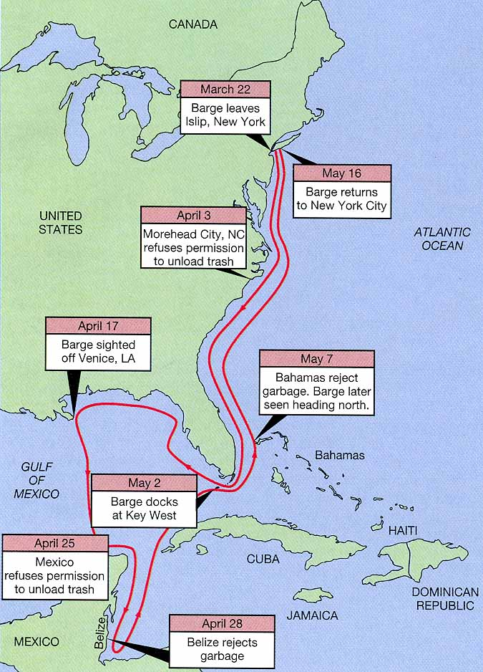
Waste Management
The voyage of the Mobro, 1987
Sought a place to dump 3200 tons of trash from Islip, Long Island
Refused permission to dump everywhere it tried
After 164 days and 6000 miles it returned to NYC where it was barred from docking
After sitting in harbor for 3 months the trash was incinerated in Brooklyn, leaving 400 tons of ash

Slide 24
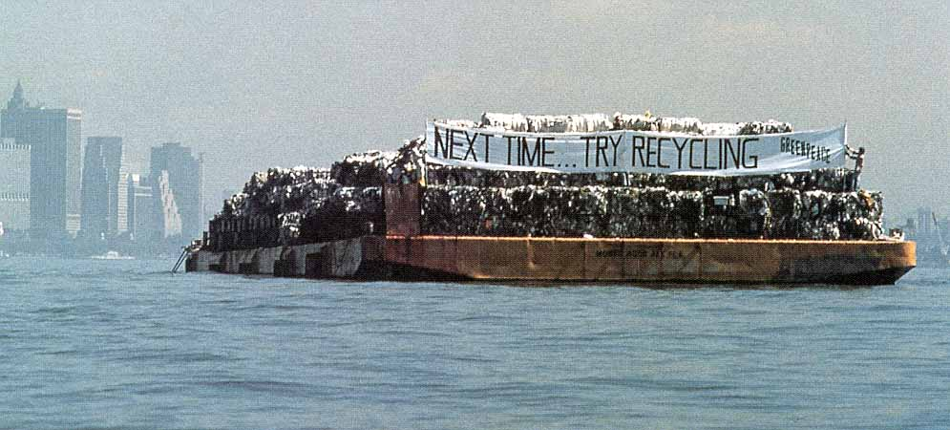
Waste Management
The voyage of the Mobro, 1987
The negative publicity catalyzed Islip to develop a recycling program
By 1989 the town recycled 35% of its solid waste
This has saved Islip $2,000,000/yr and extended the life of the landfill
Greenpeace boards the Mobro

Slide 25
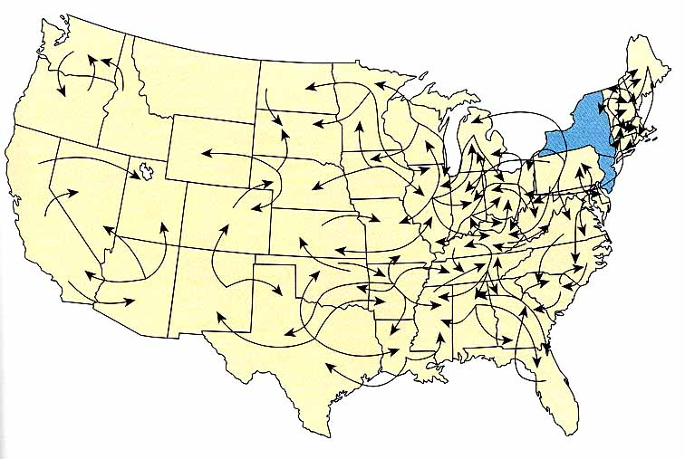
Waste Management
Interstate traffic in garbage
Couldn’t show New York and New Jersey (largest exporters)
New York ships as far as New Mexico

Slide 26
Waste Management
Hazardous chemical waste management
Huge proliferation in new chemicals without much knowledge of effects
  1000 new chemicals marketed annually in USA
  Even beneficial chemicals may not be so in all ways
  Amounts also are often huge
    US → 150 million tons of hazardous waste annually
    Used to be quite indiscriminate, so now have unknown quantities of dumps

Slide 27
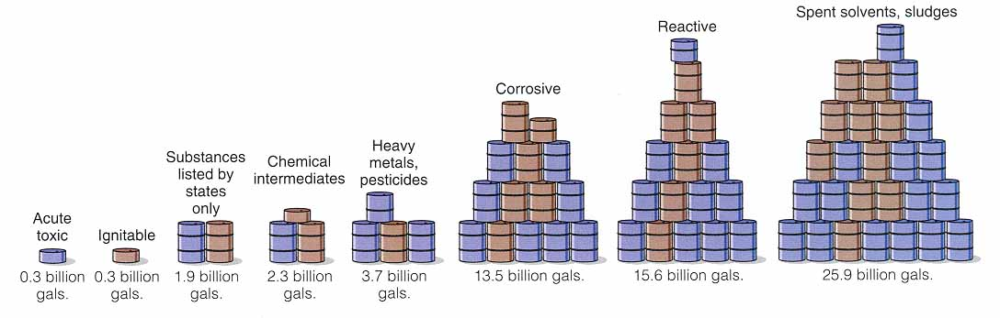
Breakdown by category of the 40,000,000,000 gallons of toxic waste generated by US industries in 1981 (total > 40 Ggal due to overlap)

Slide 28
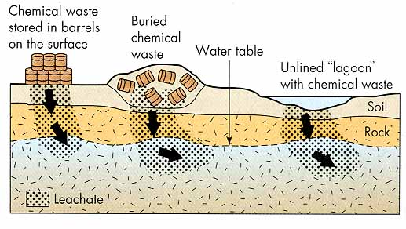
Waste Management
Hazardous chemical waste management
Barrels stored at surface or buried in shallow pits now corroded and leak
Liquid waste poured in shallow unlined pits and pools
Liquid waste carried out and dumped in fields or along roads
Notes:
All this pollutes soil, groundwater, and perhaps surface water as well

Slide 29
Waste Management
Tragedy of the Commons
  Cows and maximum individual income, whereas commons share expense
  Also works for dumping: individual savings and shared degradation
Notes:
Examples of hazardous waste tragedies:
p. 329: Elizabeth, NJ
Be sure you’ve read about Love Canal
Only in 1976 did federal gov’t step in to regulate

Slide 30
Waste Management
Mandates for Responsible Management
Resource Conservation and Recovery Act (RCRA)
  Identifies hazardous wastes and its life cycles
    Toxic
    Flammable or explosive
    Corrosive
    Unstable
  Regulates handling and record-keeping

Slide 31
Waste Management
Mandates for Responsible Management
Comprehensive Environmental Response Compensation and Liability Act (CERCLA)
  Recognizes past dumps = hazards
  Established Superfund to clean up hundreds of the worst known ones
  Changed real estate business: owners liable
Notes:
Established Superfund to clean up hundreds of the worst known ones
Really much too small to cover the job…cost estimates range from $750 billion to $1.5 trillion
Technology in infancy so often simply confine waste

Slide 32
Waste Management
Mandates for Responsible Management
1986 Superfund Amendment and Reauthorization Act (SARA)
  Provided some protection for purchasers by allowing an environmental audit at sale time
  Required all companies to report all releases (“Toxic 500 list”) in hope that publicity would shame/inhibit them
Notes:
environmental audit = study of past land use, soil & groundwater sampling...

Slide 33
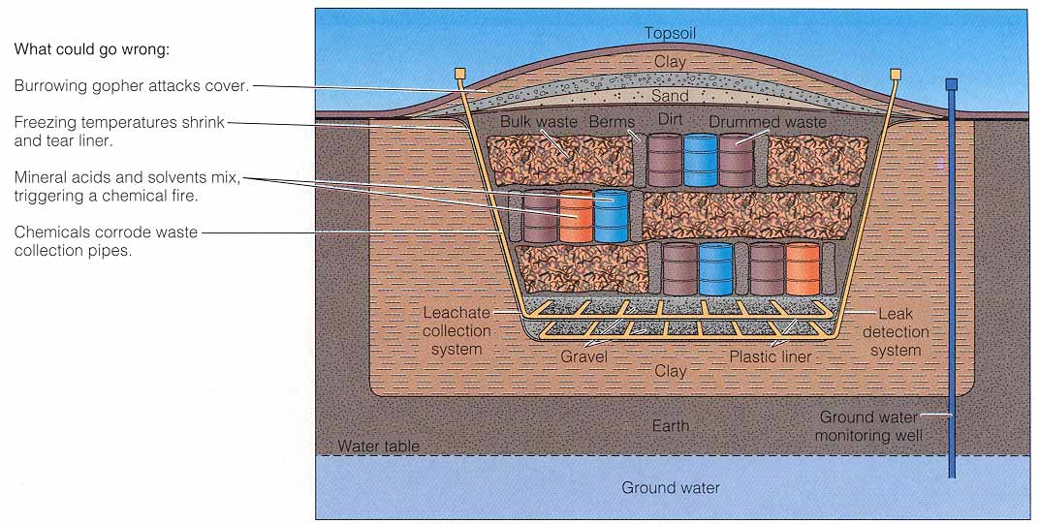
Waste Management
Management of hazardous waste:
Concern because often handled so badly in the past
1) Secure Landfill
Notes:
Confine waste, control and treat leachate, and monitor for leaks to protect groundwater & soil
Clay or heavy plastic ⇒ impermeable material for dike, liner, and cap
Modern ones require multiple barriers/layers and filters
All probably leak so some degree anyway, and realistic goal = minimize undesirable effects

Slide 34
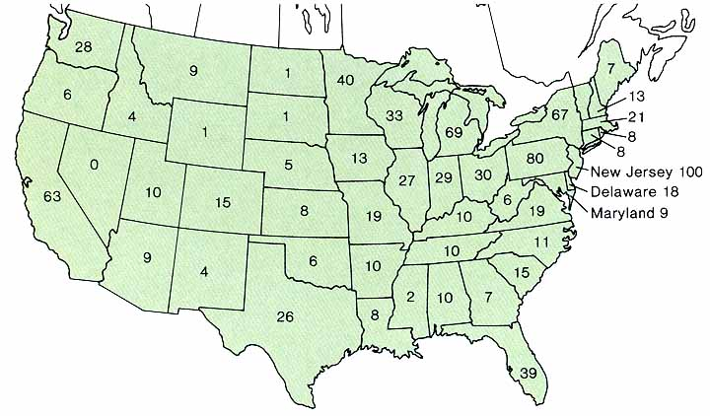
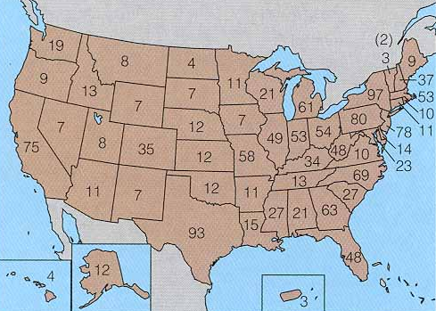
Waste Management
Management of hazardous waste:
Concern because often handled so badly in the past
Completed removals in first decade of Superfund
1980-1990.
Location of the first 951 proposed Superfund sites

Slide 35
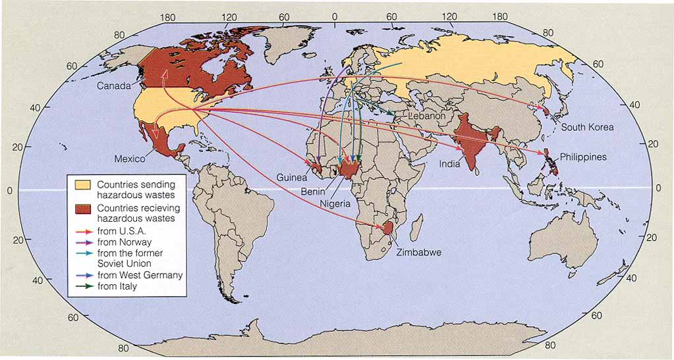
Waste Management
Management of hazardous waste:
The international trade in hazardous wastes
Notes:
Example: 55,000 tons legally exported from US to Mexico each year
Far more may be crossing international borders illegally

Slide 36
Waste Management
Management of hazardous waste:
2) Land Application
  Used for biodegradable wastes (petroleum, some organics) where organisms in the soil can degrade
  Also must monitor groundwater
3) Surface Impoundment
  Lined or unlined: both less secure than (1)
  Hold and aerate
Notes:
Boise-Cascade Wallula: big ponds where aerate & settle out gunk: then land application of solids

Slide 37
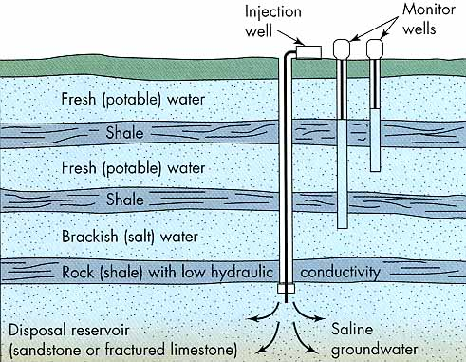
Waste Management
Management of hazardous waste:
4) Deep-well Disposal
Notes:
Drill & inject liquid wastes into deep (10²-10³ m) permeable rock = isolated from groundwater systems
Limits to suitable sites and space in each
Rocky Mtn Arsenal was doing this when caused Denver earthquakes

Slide 38
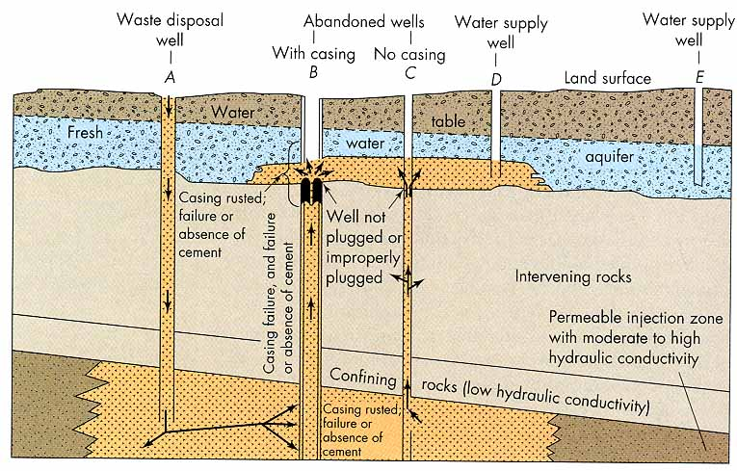
Waste Management
Notes:
Not always satisfactory.
1) Toxic spills may occur at surface
2) Uncased or corrosion of the casing may leak into aquifer
3) Waste may migrate upward through fractures
4) Old casing plugs may fail

Slide 39
Waste Management
Management of hazardous waste:
4) Deep-well Disposal
Minimize adverse effects by:
  Reducing volume by evaporation, treatment, etc.
  Treat waste so that it is compatible with reservoir rock and pre-existing fluids
  Take advantage of natural buffers:
    If acidic → limestone
    If oxidizing → carbonaceous
  Monitor at various levels

Slide 40
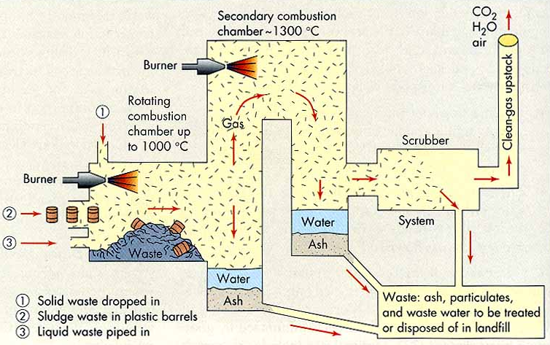
Waste Management
Management of hazardous waste:
5) Incineration
Notes:
Hi-T incineration can oxidize and break down much waste to simple compounds like CO₂ and H₂O

Slide 41
Waste Management
Management of hazardous waste:
5) Incineration
  Actually partly = treatment, because still must dispose of solid ash residue (often toxic)
  This is the plan for the Umatilla nerve gas storage facility
  Possibility of air pollution, especially for heavy metals and ash

Slide 42
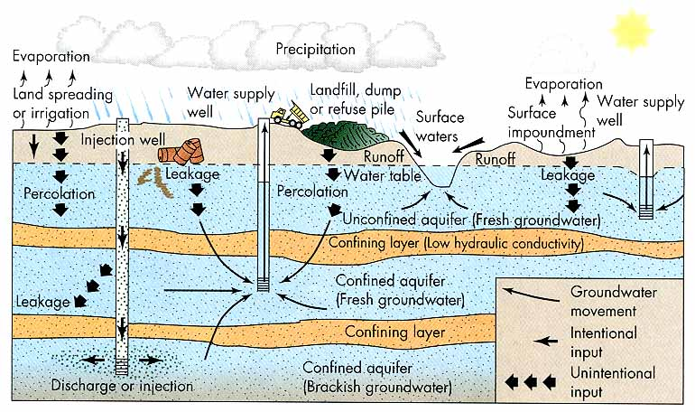
Waste Management
Notes:
None of the methods are fail-safe and there is plenty of potential to pollute the environment (especially groundwater)
Alternatives:
1) Source reduction
2) Recycling and resource recovery
3) Treatment

Slide 43
Waste Management
Some facts about recycling:
Al Cans
  May be recycled indefinitely
  Every 3 months Americans throw away enough Al to completely rebuild the domestic airline fleet
  Saves 95% of energy that would have been required ore → Al
Glass
  85 lbs of glass used per capita in US
  ~ 75% of glass in US → packaging (bottles)
  Every glass bottle that is recycled can save enough E to light a 60 watt light bulb for nearly 8 hours
  Recycling 1 ton of glass saves the E of 9 gallons of fuel
  ~ 30% of today’s average glass bottle is recycled glass
Notes:
Recycling is an elegant solution to both the waste and the resource end of many of our commodity problems
It reduces landfills while it also reduces the mining damage and energy requirements of production

Slide 44
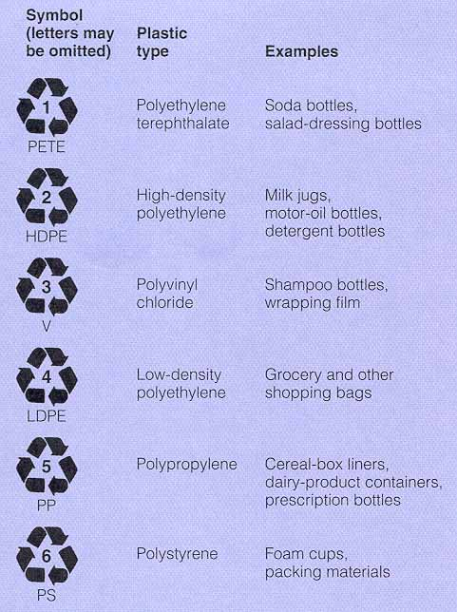
Waste Management
Some facts about recycling:
Plastic
  Americans throw away 2,500,000 plastic bottles each hour
  Plastic almost lasts forever, had the Pilgrims been able to enjoy Mayflower beer, the plastic 6-pack rings would still be around
  Plastic composes about 20% of US landfills
  Plastic production employs 5 of the 6 worst chemicals on the EPA list of “most hazardous waste”
Only 1 and 2 recyclable in WW

Slide 45
Waste Management
Some facts about recycling:
Paper
  Manufacturing recycled paper requires 64% less E that virgin paper, reduces air pollution by 74%, water pollution by 35%
  Paper industry is largest single user of fuel oil in US
  Every day US businesses generate enough scrap paper to encircle the Earth 20 times
  70% of office trash is scrap paper
  Every ton of paper that is recycled saves ~ 17 trees and enough E to heat the average home for 6 months
  Paper composes ~ 40% of US landfills

Slide 46
Waste Management
Some facts about recycling:
Scrap Metal
  Americans throw away enough steel and iron to continually supply all of the nation’s automakers
  Each year Americans abandon 3,000,000 cars
  Recycling iron and steel saves 74% of the E used to make them from iron ore and coal, while reducing mining waste by 96%
  Recycling iron and steel reduces air pollution by 86%, uses 40% less water, and produces 76% less water pollution

Slide 47
Waste Management
Some facts about recycling:
Miscellaneous Recyclable Products
  Americans dump waste oil equivalent to 25 Exxon Valdez oil spills each year (all of which is recyclable)
  Every US family, on average, produces ~ 15 lbs. of hazardous household waste each year, most of which is disposed of improperly down drains or in landfills
  ~ 80% of auto batteries are recycled, byt the remaining 20% (containing ~ 330,000,000 lbs. of lead) end up in landfills
  Household batteries account for over 50% of Hg and Cd found in landfills
  Food = 8% and yard waste = 17% of US landfills. Composting is a far better disposal method

Slide 48
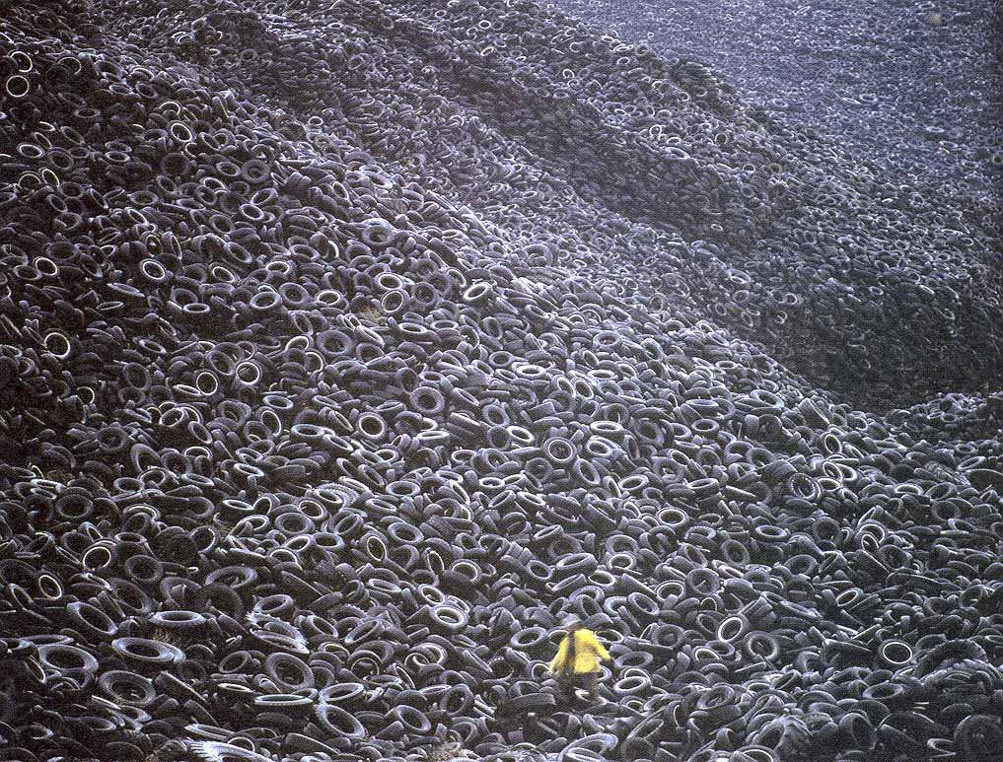
Miscellaneous Recyclable Products
  ~250,000,000 tires are thrown out annually in US, but many landfills refuse to accept them. As a result they accumulate in mountainous tire graveyards (hazardous if ignited)
  Westerly, CA power plant heats 3500 homes using tires
  Tires outperform coal as a heat fuel source

Slide 49
Waste Management
Some facts about recycling:
1996 Prices for Recycled Materials
  Shredded Automobiles $ 135/ton
  Steel Cans $ 95/ton
  Aluminum Cans $ 50/ton
  Clear Glass Bottles $ 40/ton
  Newspaper $ 24/ton
  Car Batteries $ 15/ton
  Plastic Bottles $ 10/ton
  Colored Glass Bottles worthless in WW since Asian economic collapse

Slide 50
Waste Management
A study indicated that by 2000 with an integrated system of partial recycling:
  Better design of packaging can → 10% (by weight) reduction
  Recycling programs reduce by 30%
  Composting reduce by 10%
  All 3 reduce trash by 50%, ~ same as incinerating all waste
  …and this is at a low intensity level, pilot of intensive management in East Hampton, NY → 84%
  Seattle is now at 37% (highest of any large city in US)
Notes:
Problem of infrastructure to handle recycled products (both technology and volume)
Good example: Synchilla
Bad example: Colored glass in USA, why depend on Asia?

Slide 51
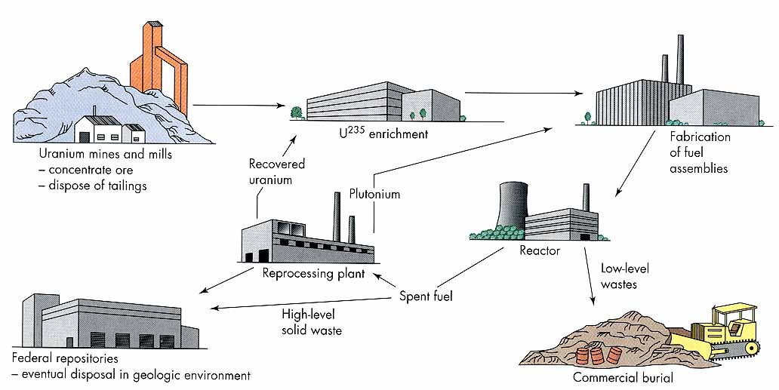
Waste Management
Radioactive Waste Management
The Nuclear Fuel Cycle
No longer done in US
Notes:
Waste: by-products of electrical generation, weapons production, biomedical and chemical research
Very problematic:
1) Can be very dangerous and have latent effects: cancers, genetic disorders…
2) Can be very long-lived so disposal may require isolation for 1000s of yrs for radioactivity to subside

Slide 52
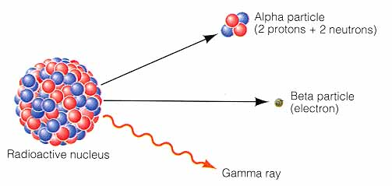
Waste Management
Radioactivity
Unstable parent isotope (such as ²³⁵U) → daughter isotope(s) + (α, β or γ) + neutrons + Energy-heat
Notes:
If organism nearby, high E particles or energy may disrupt cells (→ malignancy or DNA damage)

Slide 53
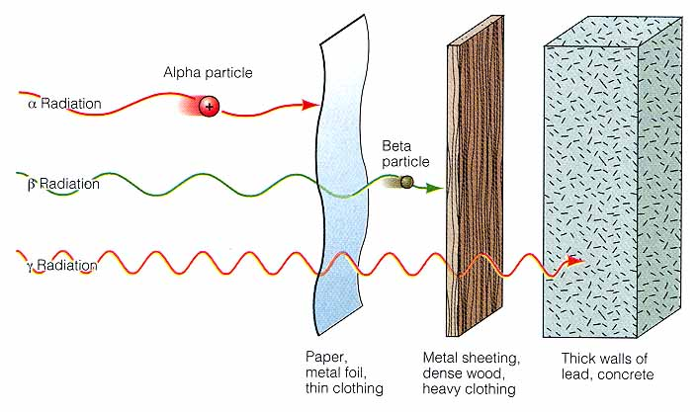
Waste Management
Radioactivity
Heavier radiation is more damaging, but penetrates less

Slide 54
Waste Management
Radioactivity
Radiation measurement
  1 curie = 37,000,000,000 disintegrations/minute
  1 rad = 0.01 joule of E absorbed by 1 kg of tissue
  A rem is factored for the damage proportionality, so is the most directly applicable to dosages
Notes:
1 curie = 37,000,000,000 disintegrations/minute
~ 1 gram of pure radium (a huge amount)
Better to use picocuries (10⁻¹² curies)
1 rad = 0.01 joule of E absorbed by 1 kg of tissue
Better than curies, because relates directly to safe dosages
But heavy α particles are more damaging than β or γ for same absorbance
A rem is factored for the damage proportionality, so is the most directly applicable to dosages
500 rems is lethal to ~ 50% of people exposed
100-200 rems induces vomiting, abortions, sterility in males
5 rem is EPA maximum allowable exposure in the workplace

Slide 55
Waste Management
Radioactivity
Some breakdown schemes are complex → series of daughters and some are also unstable
  Example: among the products of U = unstable isotopes of I, Kr, Sr, Pt
  Pt extremely toxic and poisonous
  I → thyroid → thyroid cancer (I releases to the atmosphere at Hanford)
  Sr acts like Ca, so → grass → cows → milk → bones
Notes:
Concern over ⁹⁰Sr in fallout finally resulted in the Nuclear Test Ban Treaty in the 1960s

Slide 56
Waste Management
Nuclear Fuel Cycle
Low-level waste
    Residual solutions from chemical processing
    Lab equipment
    Contaminated equipment and materials (including decommissioned and disassembled reactors)
  Don’t → much radioactivity or heat
Notes:
Rule of thumb: isolate for ~ 500 yrs
US usually buries in secure sites (15 in US, including Hanford)
But many (all?) leak to groundwater
And this is in 50 yrs, not 500!

Slide 57
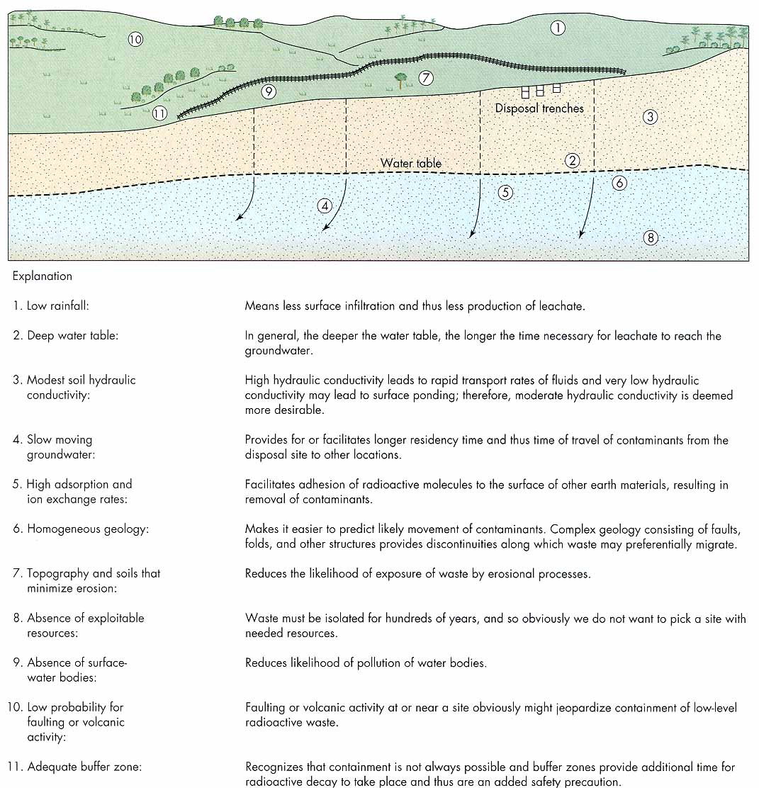
Ideal sites have the characteristics listed in Fig 12.15

Slide 58
Waste Management
Nuclear Fuel Cycle
High-level waste
  = Reactor fuel assemblies, some weapons by-products
  The BIG dilemma - very radioactive &/or toxic and long half-lives (²³⁹Pt = 24,000 yrs)
  May require depository that is very safe for > 200,000 yrs! … for whom or what?
  Where do we reprocess and store this stuff??
  While we decide, we allow “temporary” storage in pools on site at reactors.
    The stuff is accumulating: ~ 40,000 metric tons of spent fuel alone stored on low-security sites
Notes:
This must be worse than a more permanent solution, but NIMBY began here
Hanford has 177 huge tanks, over half are known to leak and > 1500 m³ have escaped
It has reached the Columbia and entered the biological food chain

Slide 59
Waste Management
Nuclear Fuel Cycle
Methods of disposal of high-level radwaste:
1) In the geologic environment
  Stable bedrock
    Seismically stable and slow hydrologic flows
    Must be studied well and characterized (geolically and hydrologically)
    Predict behavior for future Δ climate, erosion, groundwater flow, etc.
    Political risk assessment
Notes:
1982 Nuclear Waste Policy Act began an evaluation of sites and Prez chose at the end in 1987
Hanford was among finalists but Yucca Mountain, NV “won” (fewest opponents?)
Began final assessment of Y.M. in 1987 continues today

Slide 60
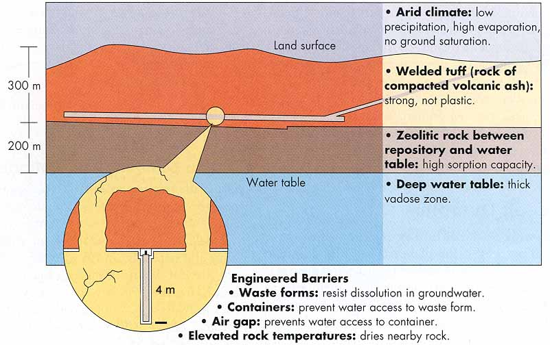
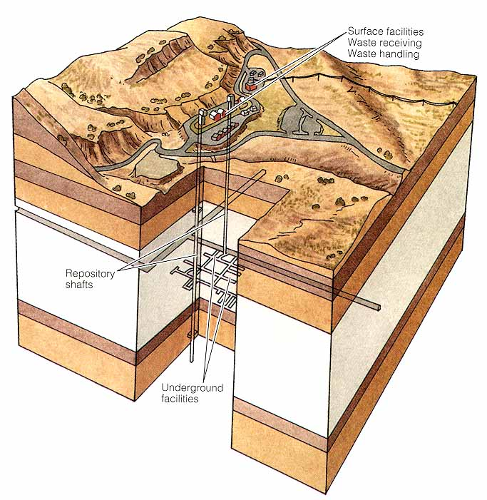
Yucca Mountain, Nevada
Notes:
Characterization of Yucca Mountain: sparsely populated, dry, above water table, poor permeability

Slide 61
Waste Management
Nuclear Fuel Cycle
Methods of disposal of high-level radwaste:
1) In the geologic environment
  Yucca Mountain may be ready by 2010 (if it meets specifications and Nevada can’t beat it)
  Nevada is seismically active
  Who really knows how well it will work for 200,000 yrs???

Slide 62
Waste Management
Nuclear Fuel Cycle
Methods of disposal of high-level radwaste:
2) Ocean dumping
  Well, it can really dilute it
  But on the other hand the ocean is very important, and currents can carry it → ??
  US prohibits radwaste, and many other wastes to → sea
  UK dumps it all in sea at Selefield

Slide 63
Waste Management
Nuclear Fuel Cycle
Methods of disposal of high-level radwaste:
2) Ocean dumping
Ocean dumping of all types of waste is a major concern:
  Tragedy of the Commons again. International areas.
  What happens when we actually pollute the oceans?
    Lose valuable spawning grounds, shellfish beds, marine life
    Already see loss of whole fishing fleets and industries:
      Mediterranean sardine went early, as did Scandinavian cod, herring
      N. Atlantic fishery nearly gone: Newfoundland fishermen laid off
      whole ways of life lost and major cultural shifts

Slide 64
Waste Management
The ABCs of waste disposal
NIMBY Not In My Back Yard
NIMFYE Not In My Front Yard Either
PIITBY Put It In Their Back Yard
NIMEY Not In My Election Year
NIMTOO Not In My Term Of Office
LULU Locally Unavailable Land Use
NOPE Not On Planet Earth

